Slide 1
Wavelet-based clustering of time series
Josue Kuri, Felix Huang, Ssurey Moon,Kathy Norman

Slide 2
Presentation outline
Time series clustering
Wavelet transformation
Wavelet-based feature extraction
Experimental evaluation
Examining Earthquake data with respect to Fracking
Conclusions

Slide 3
Time series clustering
Time series: sequence of data points indexed by time.
Clustering: Exploratory technique to understand underlying patterns.
Dimensionality reduction.
Feature selection vs feature extraction.
Feature extraction: SVD, DFT, DWT

Slide 4
Wavelet transformation
A time-frequency transformation technique for hierarchical decomposition of signals.
Initially developed for seismic signal analysis.
Decomposition of a signal into:
An approximation of the original signal
Coefficients for increasing levels of detail
Reconstruction
Exact original or approximate depending on number of coefficients used.

Slide 5
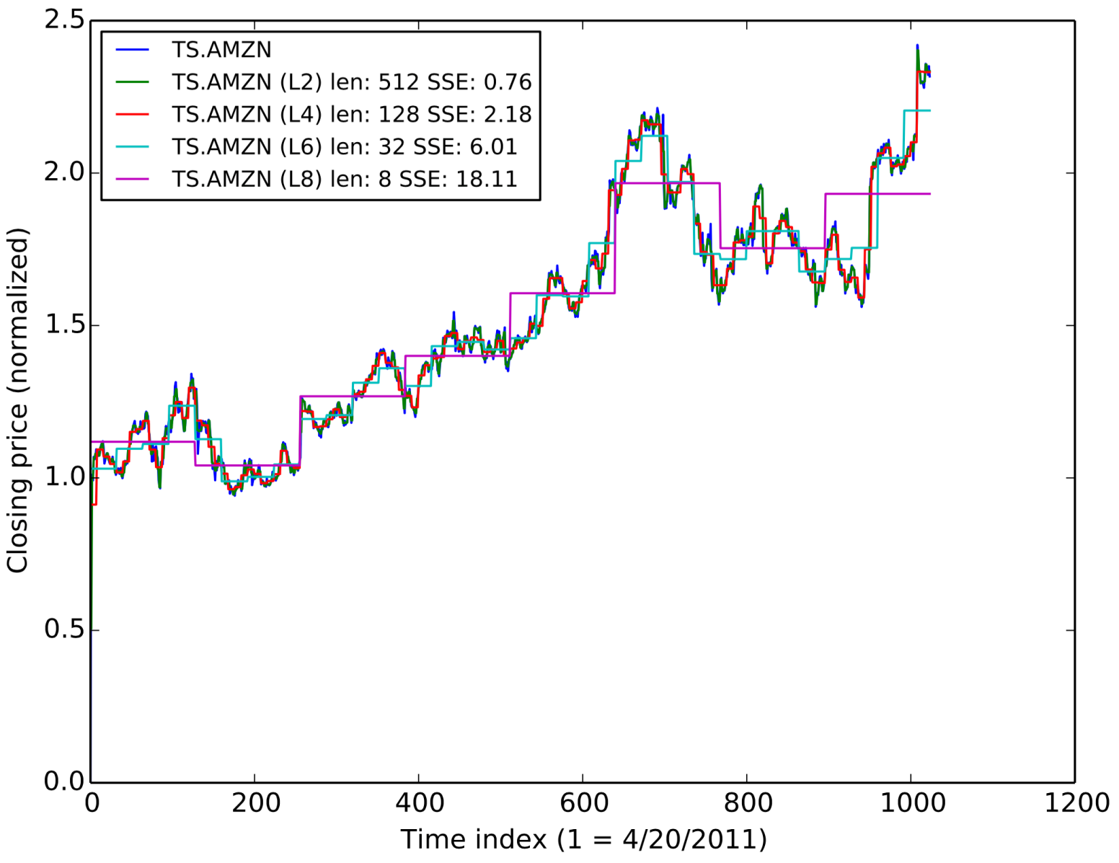
Reconstruction of time series

Slide 6
Wavelet-based feature extraction
Each time series has 1024 elements
For a given level of decomposition r, a discrete wavelet transformation generates:
An A vector of approximation coefficients
r D vectors of detail coefficients
Example: For r=2
An A vector of length 256
A first D₂ vector of length 256
A second D₁ vector of length 512
We use [A,D₂] as the feature vector for the time series

Slide 7
Experimental evaluation
Data sets
Closing stock prices
Currency exchange rates
Earthquake data
Algorithms
Mini-Batch K-Means
Affinity Propagation
Spectral Clustering
Ward
Agglomerative Clustering
Birch
DBSCAN
Evaluation
Silhouette coefficient

Slide 8



Evaluation criteria
Unsupervised learning
No label, No SSE(Sum of Square Errors)
Internal evaluation using clusters themselves
Silhouette coefficient
a : average distance between a random node in a cluster and other nodes in the cluster (Cohesion).
b : minimum value of the average distance between a random node in a cluster and other nodes in another cluster (Separation).

Slide 9
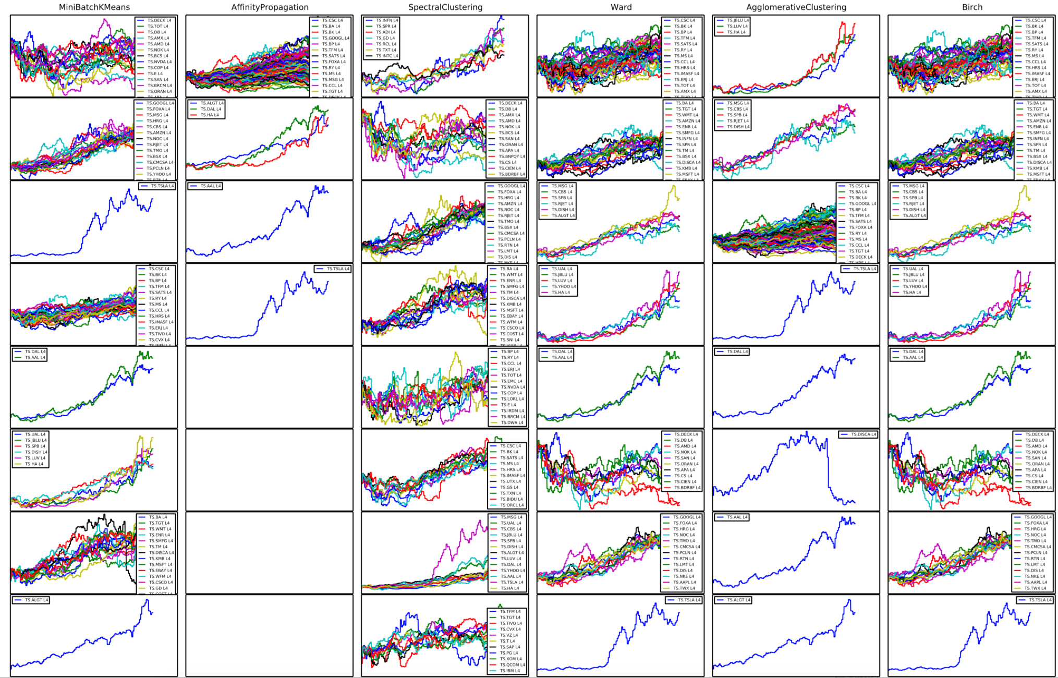
Clustering of stock prices

Slide 10
Conclusions
Wavelet transformation as a feature extraction mechanism.
Both, qualitative and quantitative evaluation needed to understand data and when an algorithm is a good fit.
Silhouette coefficient not significantly sensitive to dimensionality reduction.
A combination of measurements needed for a better evaluation.

Slide 11
Examining Earthquake Data using Time Series Analysis
Can we use ‘Clustering Time Series using Wavelet Transformations” for evaluating Earthquake data?
Is the a relationship between Fracking and Earthquakes?

Slide 12
Earthquake Data Details
Data taken from: http://earthquake.usgs.gov/data/
All earthquakes for 2011-2014 were collected, and the categorized according to UTM (grid map of the Earth, excluding the Polar Regions)
Some documentation suggested that with respect to examining seismic activity, one should examine quakes with magnitude >3. Given the substantial increase in quakes in 2013 & 2014 and the lack of seismic expertise, all data was used
Included ~500 questionable records for 2013 & 2014

Slide 13
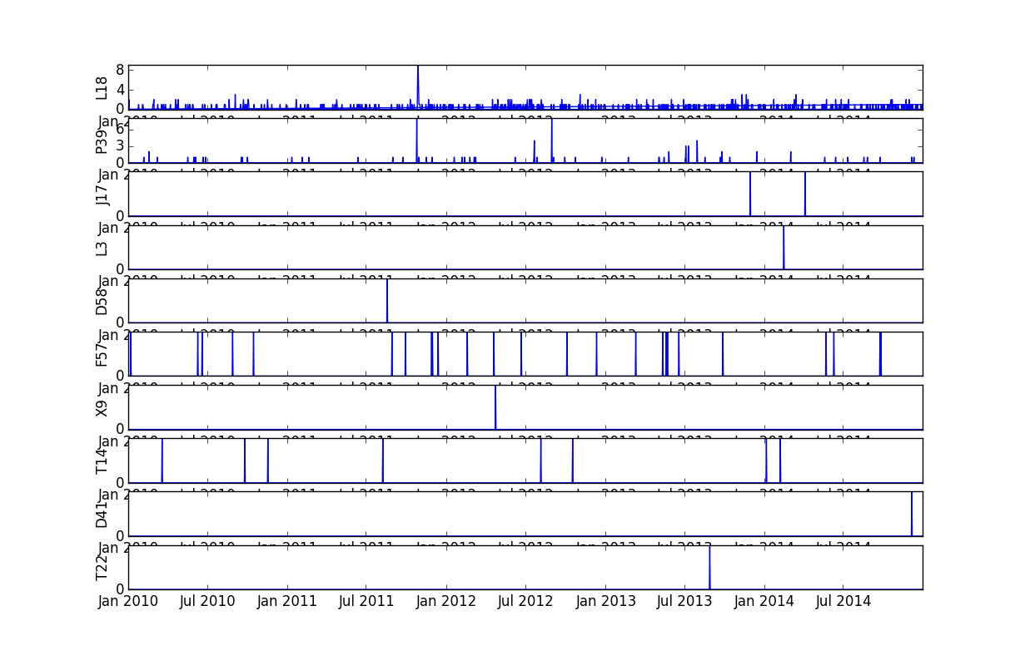
Time-series Earthquake data

Slide 14
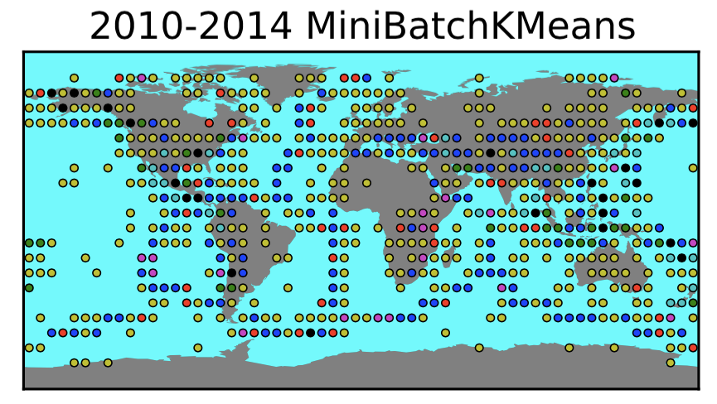
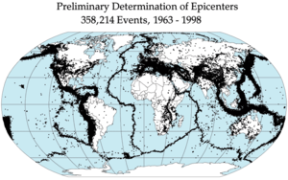
Clustering of earthquake freq.:
Clustering Mirrors Known Epicenters

Slide 15
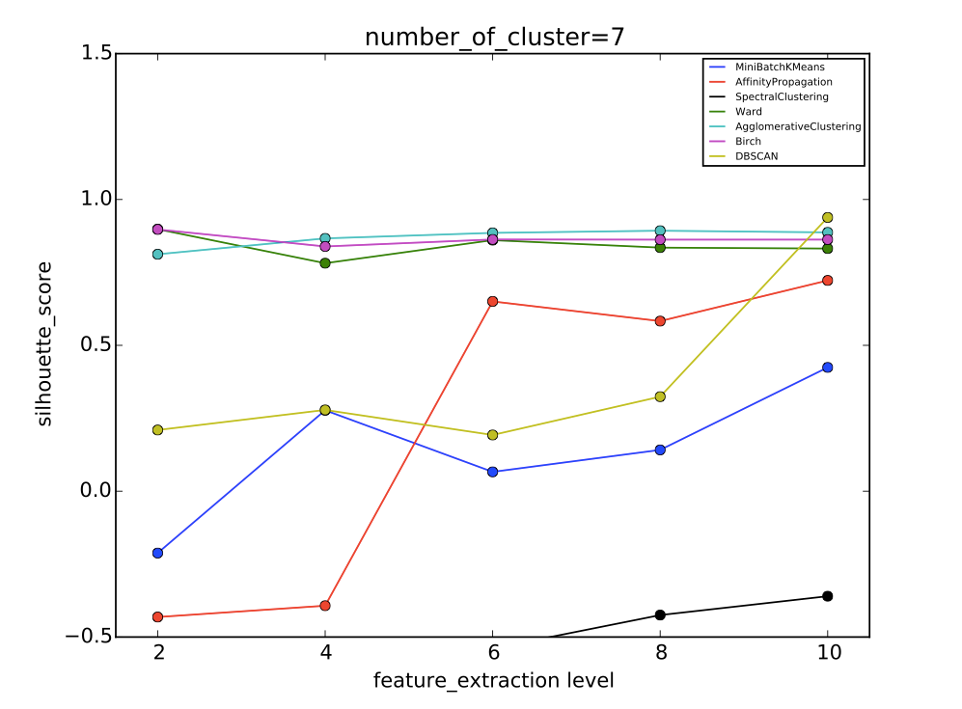
Why KMeans? And the Difference between Stock & Earthquake data.

Slide 16
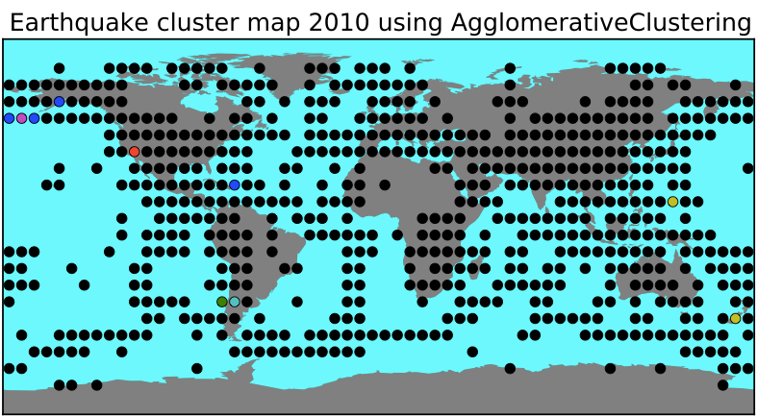
Agglomerative Clustering scored high
And put most of the Quakes are in 1 cluster!

Slide 17
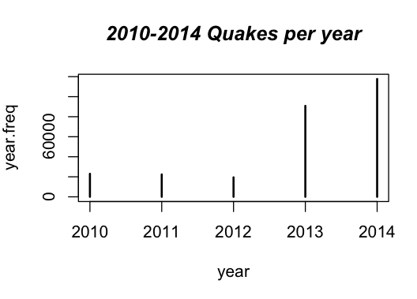
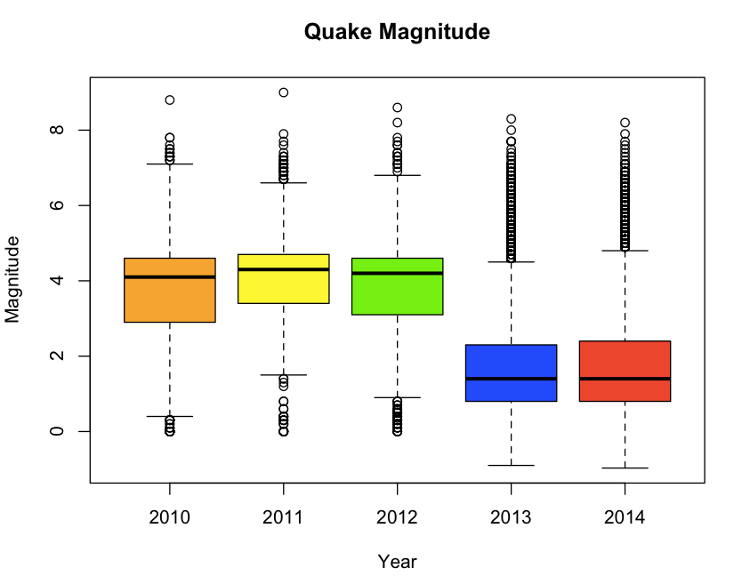
Data Summary:
Global Quake Average Magnitude
Quakes#s:
2010: 23,010
2011: 22,341
2012: 19,438
2013: 90,824
2014: 117,669
Note: for 2013 & 2014 50% of the data is < 3 magnitude

Slide 18
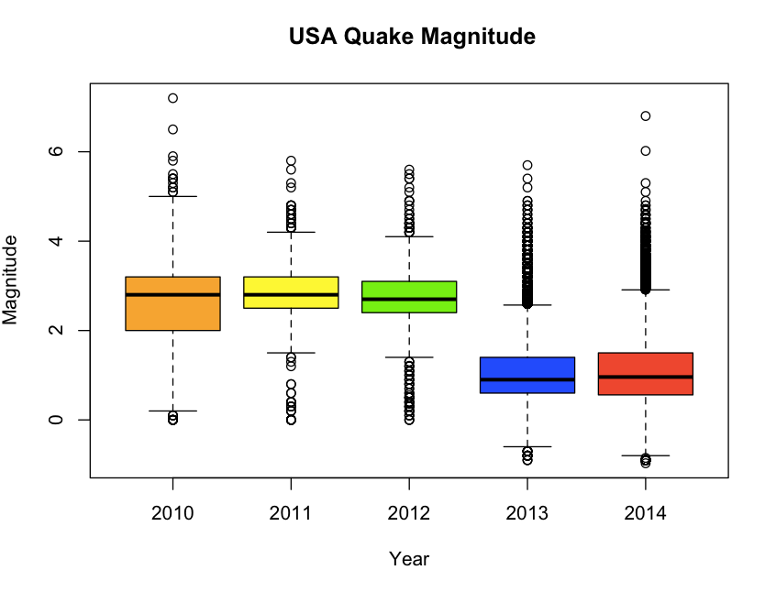
Data Summary: USA Quake Average Magnitude

Slide 19
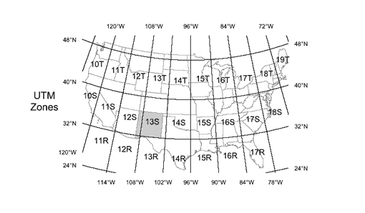
Data Summary: USA UTM (Universal Transverse Mercator)

Slide 20
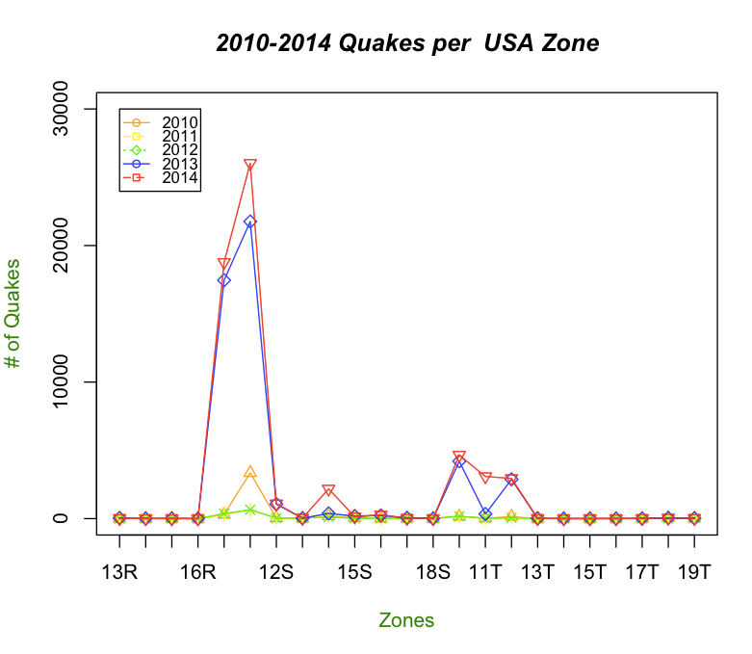
Data Summary: MTU 10S, 11S, 14S, 10T, 11T, 12T have the Highest # of Quakes

Slide 21
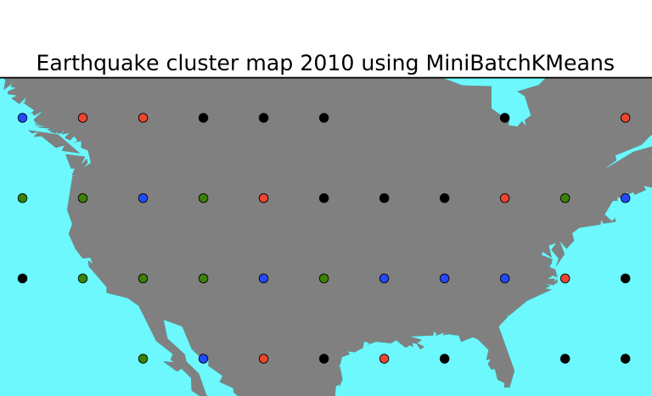
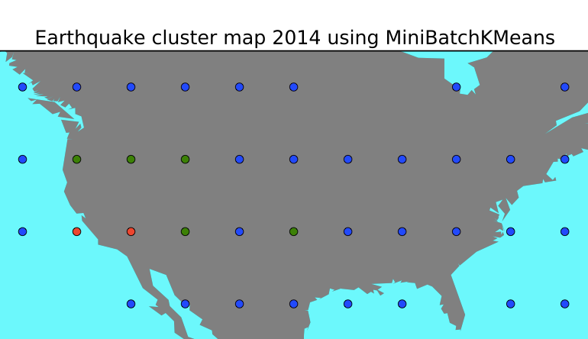
USA Quakes using MiniBatchKMeans (Level 8, Cluster=4)
2010: Quake numbers are flat across MTUs, must be clustering in magnitude/depth
2014: green & red cluster is high quake activity & match reported quake activity

Slide 22
Conclusion
Earthquake data can be examined using Time Series with Wavelet Transformations. However due to the sparse nature of the data, high level of feature extractions (eg. level 10, 2**10 data points) is recommended.
There is a relationship between Fracking and increased Earthquake frequency.
The presence of Fracking in a geography is linked to Earthquakes of <= magnitude 3. This does not exclude the possibility that Fracking is linked with Earthquakes of >3 magnitude.

Slide 23
Foreign Currency Exchange (FOREX)
30 FOREX pairs are collected from Federal Reserve web.
For missing items, we do interpolate() in python to create 1024 time series data for each pair.
We use pickle to save prepared data and load them later.
We do normalization on each FOREX pair.
We apply Kmeans on these 30 pairs. Kmeans detects similar pairs South Africa vs USD and Brazil vs USD. Kmeans finds similar pairs USD/Euro and USD/Australia in a cluster.
We apply Spectral clustering. Spectral finds the following paris in clusters : Japan/USD and Norway/USD, South Africa/USD and Brazil/USD, and USD/Euro and USD/Australia pairs.
We apply clustering algorithms : MiniBatchKMeans, AffinityPropagation, SpectralClustering, Ward, Agglomerative, and Birch. Comparison graphs are as following slides.

Slide 24
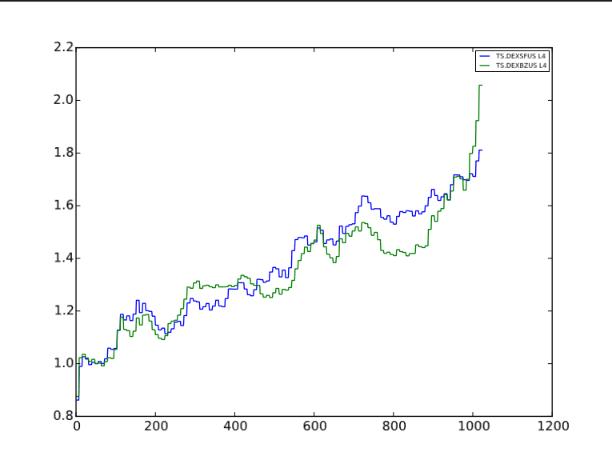
Kmeans detects similar pairs South Africa vs USD and Brazil vs USD

Slide 25
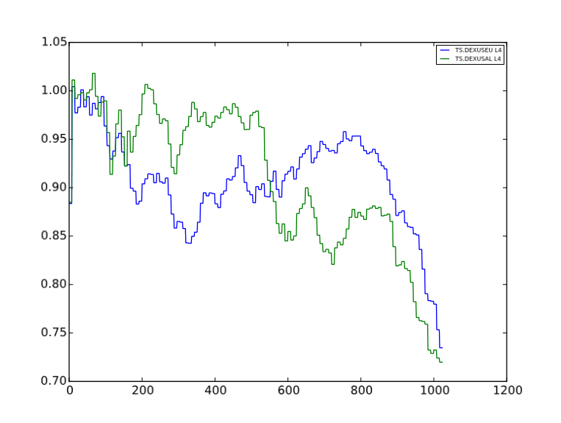
Kmeans finds similar pairs USD/Euro and USD/Australia in a cluster

Slide 26
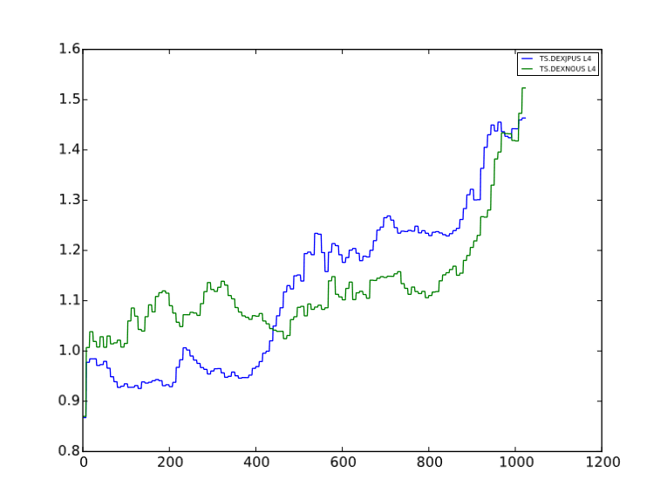
Spectral clustering finds similar pairs Japan/USD and Norway/USD in a cluster

Slide 27
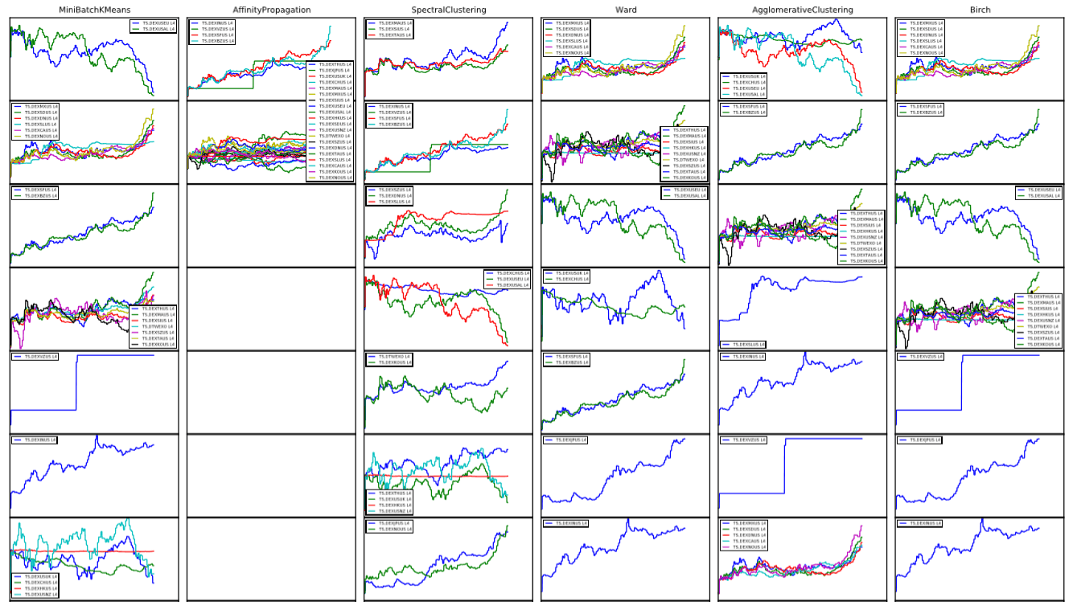
Clustering Algorithms : MiniBatchKMeans, AffinityPropagation, SpectralClustering, Ward, Agglomerative, and Birch

